Slide 1
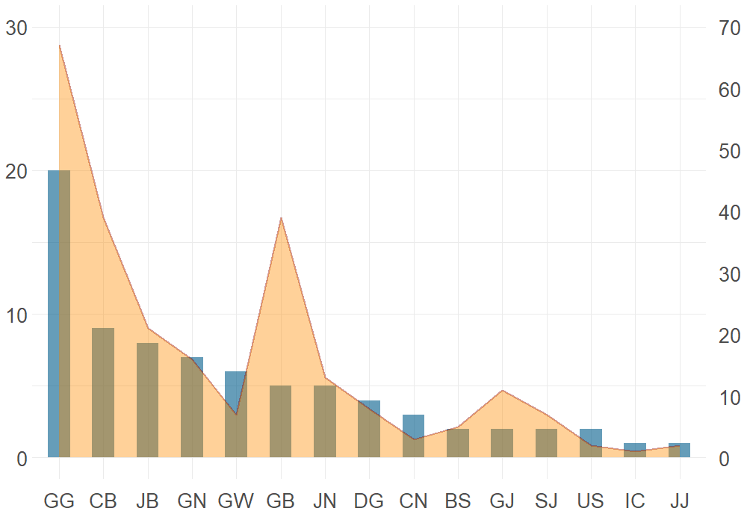
Manufacturer
Products
Region

